Slide 1
CPRG 307
Module 1
Database Objects that Assist Programmers

Slide 2
Objectives
Look at three different objects in the database that, for software developers, can be helpful:
  Sequences
    CREATE SEQUENCE seq-empno;
  Synonyms
  Views

Slide 3
Sequences

Slide 4
What are sequences?
Allow for the automatic generation of numbers
Good for primary key values that do not have a predefined meaning – just need a unique number
Sequences are another type of object that is available in the database, like a table or index
Eliminate the need for the programmer to write a number generator
Simplifies the code for readability

Slide 5
Creating a new sequence…
This is a DDL command
The name must be unique within the user account (schema) creating the new sequence
Sequences are not connected to specific tables
  Unlike other RDBMS systems like MySQL where the auto generated column value is specific to a table and column
  Starting in Oracle 12c, you can create a table with a sequence value as a default for a column and the database will automatically create a sequence for this, but the sequence is still a separate object that is independent of the table
Notes:
CREATE SEQUENCE seq-empno;

Slide 6
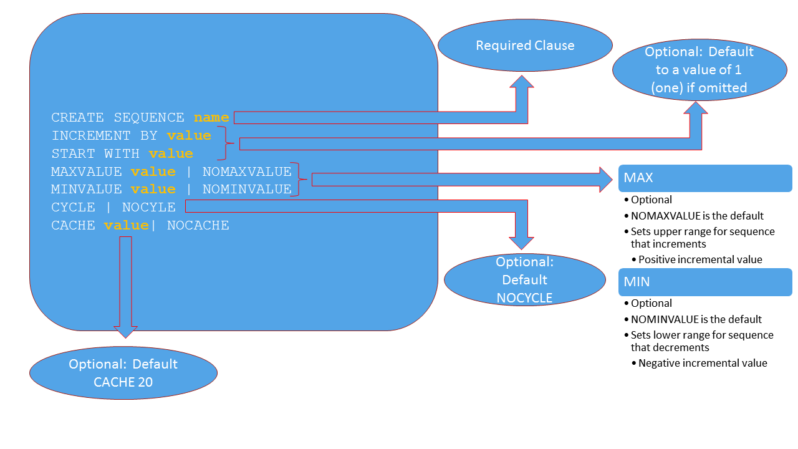

Slide 7
Example
CREATE SEQUENCE seq_course_code
INCREMENT BY 10
START WITH 5;

Slide 8
Modify existing sequences…
Every option available with the creation of new sequences is also available with modifying existing sequences except for one:
  We cannot change the starting value of a sequence
Changes to a sequence definition only effect sequence values generated AFTER the changes have been applied to the database; they have no effect on values that have already been generated

Slide 9
Example
ALTER SEQUENCE seq_course_code
INCREMENT BY 5;

Slide 10
Remove existing sequences…
Dropping a sequence removes it from the database but it has no effect on the numbers that have been generated to-date

Slide 11
Example
DROP SEQUENCE seq_course_code;

Slide 12
Using sequences…
Two options can be used when accessing a sequence: CURRVAL and NEXTVAL
CURRVAL
  Does not increment the sequence, simply retrieves the current value of the sequence (the last number that was generated)
  CURRVAL is actually a sessional variable and must be initialized in a user’s session before it can be used or an error will occur
    To initialize, a NEXTVAL must have been issued at least once in that user session
NEXTVAL
  Increments the sequence to the next value and retrieves the value

Slide 13
Using sequences (SQL)…
Sequences cannot go back in time. The minute a sequence has been incremented there is no way to “backup” to get a past value
There is the possibility that a value can be “lost” or not used in an application
Sequences can be used in DML and DQL operations:
  INSERT
  UPDATE
  SELECT

Slide 14
Examples
INSERT INTO emp
(empno, lname, fname, title)
VALUES
(seq_emp.NEXTVAL, 'Smith', 'Fred', 'Analyst');
SELECT seq_emp.CURRVAL
FROM dual;

Slide 15
Using sequences (PL/SQL)…
We will be coming back to sequences and PL/SQL later in the course
As the name of this procedural language (PL/SQL) implies, SQL is included as a component
Similar to SQL commands on the command line with sequences, we can use sequences in SQL (DML and DQL) that are part of a PL/SQL program
The syntax for INSERT and UPDATE commands remain the same, but SELECT is slightly different

Slide 16
Using sequences (PL/SQL)…
In PL/SQL, when we have a SELECT that is not part of an explicit cursor, we have to add a new clause to complete the syntax
As a SELECT statement retrieves data, we need to create a variable and assign the returning value from the SELECT into this variable
  This new clause is how the assignment is performed in the PL/SQL language

Slide 17
Example
SELECT seq_emp.NEXTVAL
INTO v_sequence_variable
FROM dual;

Slide 18
Using sequences (PL/SQL)…
Starting with version 11g, we no longer need to retrieve a sequence value using a SELECT…INTO statement
Can now perform a direct assignment into the variable

Slide 19
Example
v_sequence_variable := seq_emp.NEXTVAL;

Slide 20
Synonyms

Slide 21
What are synonyms?
Act as an alias for database objects
Software developers use them to redirect users to a specific table that is owned by a different user
  Synonyms do not override security permissions
The most common type of synonym is a public synonym
This is a synonym that can be seen by all users in the database
  As mentioned previously, this does not effect the underlying security permissions

Slide 22
Public Synonyms…
There are two types of synonyms that can be used:
  Public
  Private
Public is the most commonly used and the one that aids developers the most
  This is the one we will focus on in this course

Slide 23
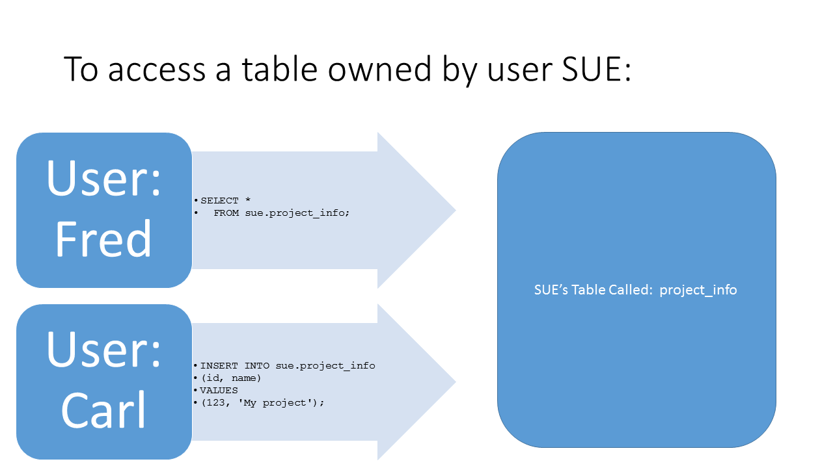

Slide 24
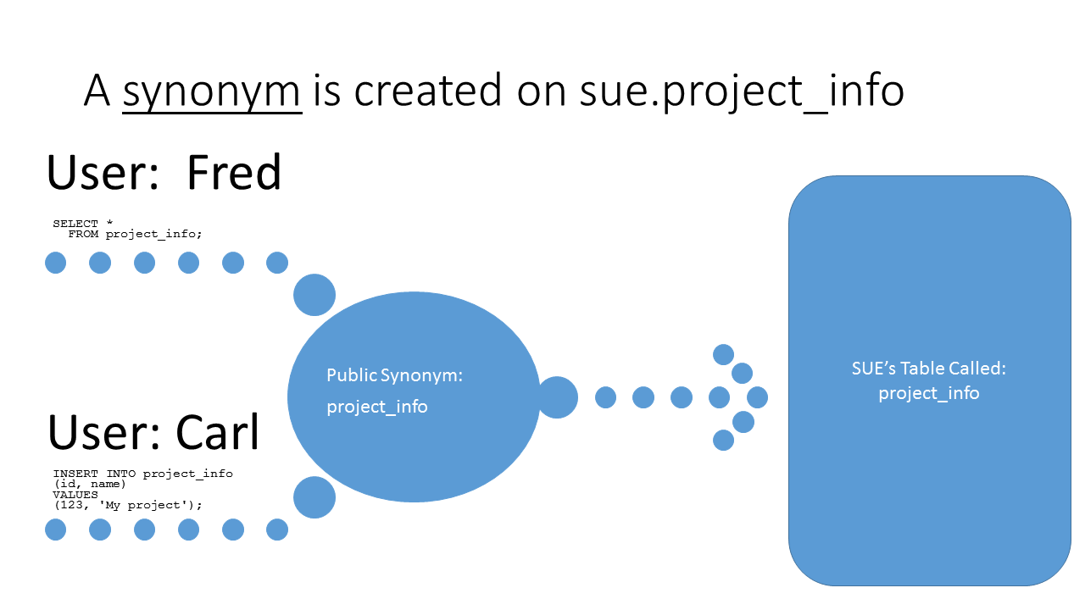

Slide 25
Public Synonyms…
To be able to create a public synonym, the user account issuing the command must be given permission to create this type of synonym
Because public synonyms can be seen by all users, caution is needed before these synonyms are removed from the database
  Only a user with DBA privileges can remove a public synonym from the database

Slide 26
Examples
CREATE PUBLIC SYNONYM project_info
FOR sue.project_info;
DROP PUBLIC SYNONYM project_info;

Slide 27
Views

Slide 28
What is a view?
Views are another type of database object (like a table or sequence)
Views reference tables
Views are defined by a query (i.e. SELECT statement)
Views do not store any actual data
  They store the query
Two purposes to views:
  Reduce complexity of queries
  Restrict a users’ access to sensitive data

Slide 29
View Types…
There are three types of views
  Inline
  Simple
  Complex

Slide 30
Inline View…
Inline views were covered in your second semester database course
This type of view exists only while the SELECT statement being executed exists
It is when you have a subquery in the FROM clause of a SELECT statement
We will not be looking at this type of view any closer this semester

Slide 31
Example
SELECT dname, total_sal
FROM dept d, (SELECT deptno,
SUM(sal) total_sal
FROM emp
GROUP BY deptno) tsal
WHERE d.deptno = tsal.deptno;

Slide 32
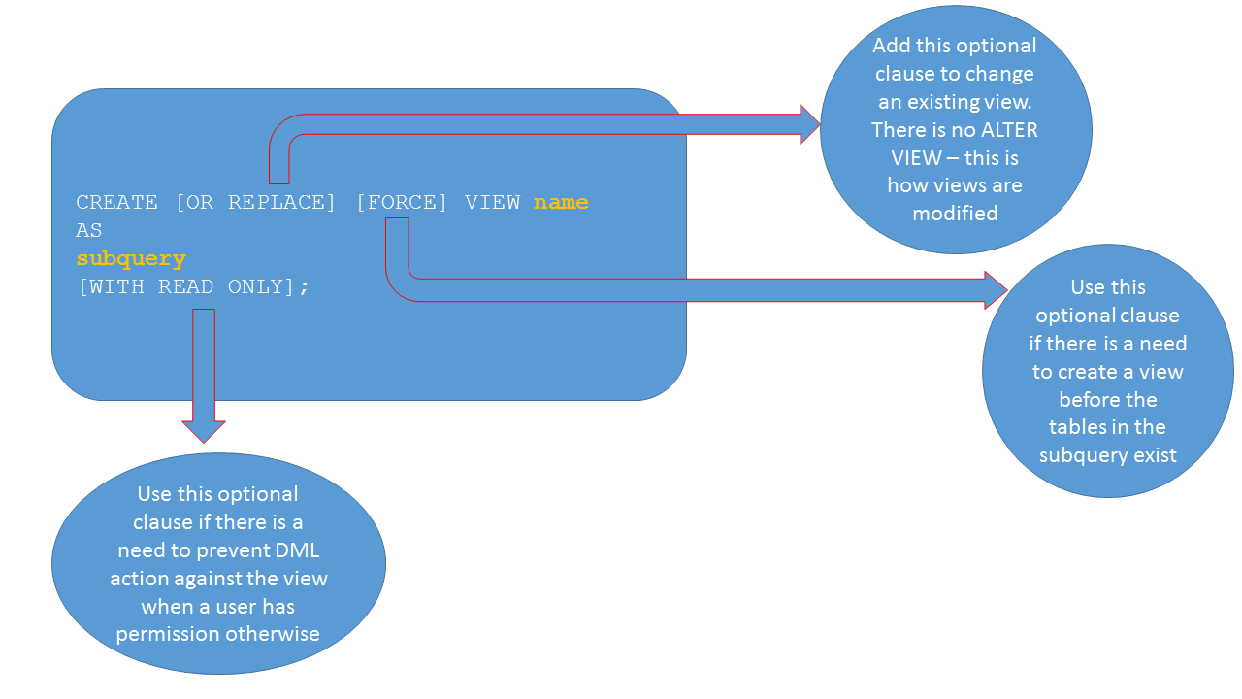

Slide 33
Simple and Complex Views…
Simple and Complex views are both separate objects in the database and exist beyond the running of a SELECT statement which is what makes them different from an inline view
We classify a view as simple or complex based on the complexity of the SELECT statement that makes up the view object

Slide 34
Simple View…
The SELECT statement:
  References only one table
  Contains no group functions
  Contains no calculated values
  Does not have DISTINCT or UNIQUE
  Basically, there is a one-to-one correlation between a row being displayed and a row in the table

Slide 35
Example
CREATE OR REPLACE VIEW vw_emp AS
SELECT ename
FROM emp
WHERE sal > 1000;

Slide 36
Complex View…
The SELECT statement:
  References more than one table
  Can include data grouping
  Can include calculated values
  Can include DISTINCT or UNIQUE

Slide 37
Examples
CREATE OR REPLACE VIEW vw_dept_info AS
SELECT ename, dname
FROM emp e, dept d
WHERE e.deptno = d.deptno
AND sal > 1000;
CREATE OR REPLACE VIEW vw_salary_info AS
SELECT deptno, SUM(sal) total_salary
FROM emp
GROUP BY deptno;

Slide 38
Views and DML …
When we perform DML operations (INSERT, UPDATE, DELETE) against a view the data in a view is not being modified
  Views hold no data to modify
  Views contain only the SELECT statement that was provided during creation or subsequent changes
  DML operations against a view will actually be directed to the base table(s) of the SELECT statement that defines the view (those listed in the FROM clause)

Slide 39
Views and DML …
There are limitations on the DML operations that can be performed against views:
  Must be given permission to perform these operations (will talk about this more next semester)
  All constraints must still be adhered to
  There are specific limitations based on whether it is a simple or complex view

Slide 40
Simple Views and DML …
DML operations on a simple view are pretty straight forward as they always maintain that one-to-one relationship between the row that is displayed and the row in the table
The only things to consider are the constraints on the base table
  The DML operation cannot violate a constraint
    A constraint error will be thrown if it is violated and the DML operation will be unsuccessful

Slide 41
Complex Views and DML …
DML operations on a complex view are not as straightforward as with the simple view, cannot always be performed, and if it can there are limitations
DML operations on a complex view are only possible if the one-to-one correlation between a row being displayed and a row in the table is maintained
  Group functions, GROUP BY, DISTINCT, and UNIQUE remove this correlation so any complex view that contains these cannot have DML operations performed against it

Slide 42
Complex Views and DML …
Generally, if the only complexity to a view is that is has more than one table listed in the FROM clause, limited DML operations can be performed against this view
  As with simple views, constraints must be adhered to
  Cannot insert a value into a column that is based on an arithmetic expression
  No matter how many tables are listed on the FROM clause, only one of the tables can have its data modified by the DML operation
    The database calls the table the key-preserved table
    It is defined by the database

Slide 43
Key-Preserved Table…
The key-preserved table, is the table that holds the primary key for the view
If we had two tables in the FROM clause of the view, the key-preserved table would be the foreign key table

Slide 44
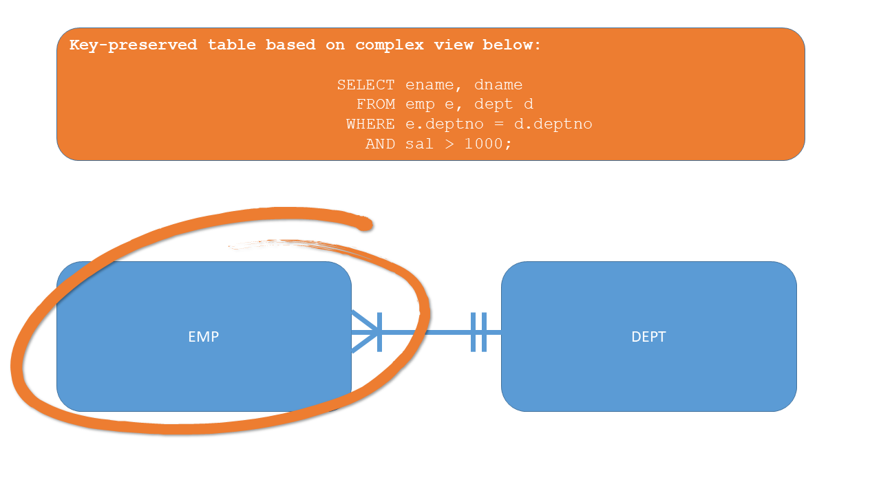

Slide 45
Using Views…
After a view has been created, it is accessed exactly as you would a table

Slide 46
Examples
DESCRIBE vw_emp
DESCRIBE vw_salary_info

Slide 47
Examples
SELECT *
FROM vw_emp;
SELECT deptno, total_salary
FROM vw_salary_info
WHERE deptno = 20;

Slide 48
Removing Views…
When removing a view from the database we are removing the object
Removing a view has no effect on the table data the view is referencing
There is no dependency between views and tables from a structural point of view so removing one does not remove the other although it may invalidate a view if the table it references is removed

Slide 49
Example
DROP VIEW vw_emp;

Slide 50
Data Dictionary Views

Slide 51
What is the data dictionary?
The data dictionary is a collection of tables that store information about everything contained in our database
The data dictionary is what allows a functional language like SQL to work
  We do not tell the RDBMS where to get the data when we write a SELECT statement, we simply tell the RDBMS what information we want to retrieve
    The RDBMS uses the information in the data dictionary to determine the physical location of the requested data

Slide 52
What is the data dictionary?
The core tables of the data dictionary are owned by the SYS user (we will be looking at this user more closely next semester)
Without the data dictionary, there would be no database
Because of the importance of the data dictionary tables, we never access them directly (they are managed by the RDBMS)
  We access the data dictionary through various views that are available to us
  There are too many views available to memorize
  This semester there may be some that will come in handy; we will use data dictionary views more extensively next semester

Slide 53
Data Dictionary View Categories…
Data dictionary views, and the type of information available in them, are categorized to help us determine which view is the most appropriate to use
We will only be using a subset of the different categories
In this class we will mention four (4) categories
For software developers, only two would be important to use; the other two we will use next semester for database administration

Slide 54
Data Dictionary View Categories…
The four (4) categories we will mention are:
  V$
  DBA_
  ALL_
  USER_

Slide 55
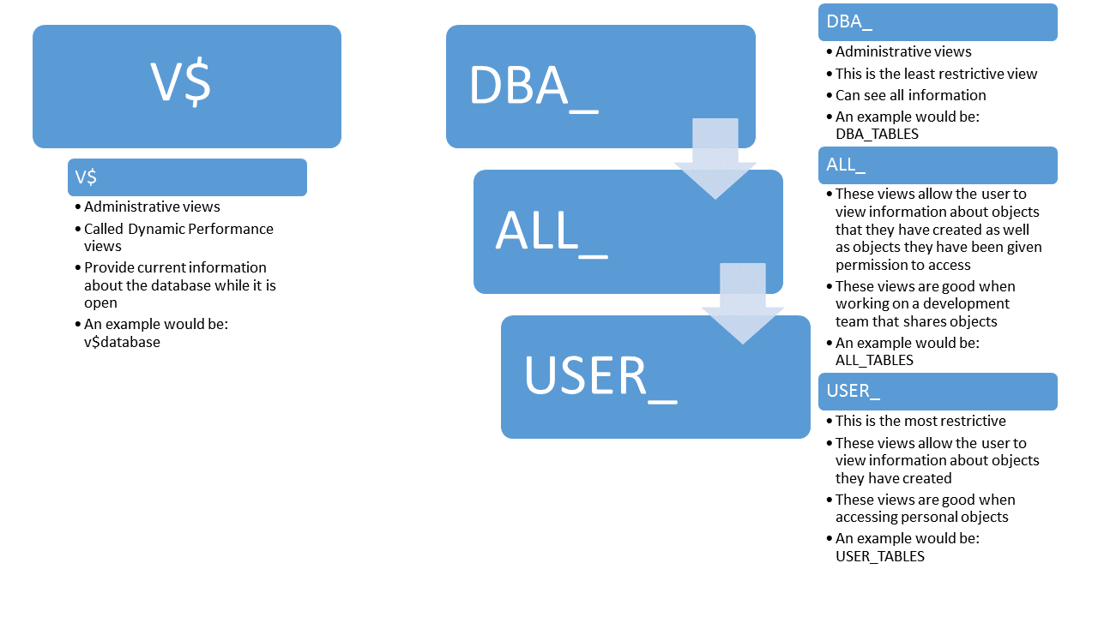

Slide 56
Useful Data Dictionary Views for this Module…
USER_SEQUENCES
USER_SYNONYMS
USER_VIEWS
USER_TABLES

